Slide 1


GCA5 SPONSORSHIP
DECK
Silver & Bronze Level
Notes:
Title Screen

Slide 2
Table of Contents
GCA Sponsorship Deck
GCA Overview…………………………………………….. 3
GCA Media Impact…………………………………….. 4
GCA Participant Demographics ………………5
GCA5 Forecast..……………………………………………6
GCA5 Value..………………………………………………….7
Platinum Level Sponsorship……………………..8
Gold Level Sponsorship……………………………..9
Participant Experience…………………………….10
Conclusion…………………………………………………….11

Slide 3

Great Canadian Appathon
The Only National Game Development Hackathon
The Great Canadian Appathon (GCA) was created in 2011 as a way of engaging with and giving back to the student game developer community.
The Great Canadian Appathon (GCA) is a 48-hour national competition open to Canadian college and university students from coast-to-coast. Aspiring game developers race against the clock to design the next hit mobile game.
Since it’s inception, the GCA quickly grew to become a constant in students’ calendars, an annual event where the best computer engineers and game developers test their skills in the field, and at many schools an accredited extracurricular activity.
GCA1
GCA²
GCA³
GCA⁴
GCA
Mar 2011
Oct 2011
Sept 2012
Jan 2014
4 Provinces
7 Schools
94 Teams
296 Students
54 Games
All Provinces
40+ Schools
150+ Teams
500+ Students
100+ Games
Largest competitive hackathon in Canada for 4 times running!

Slide 4
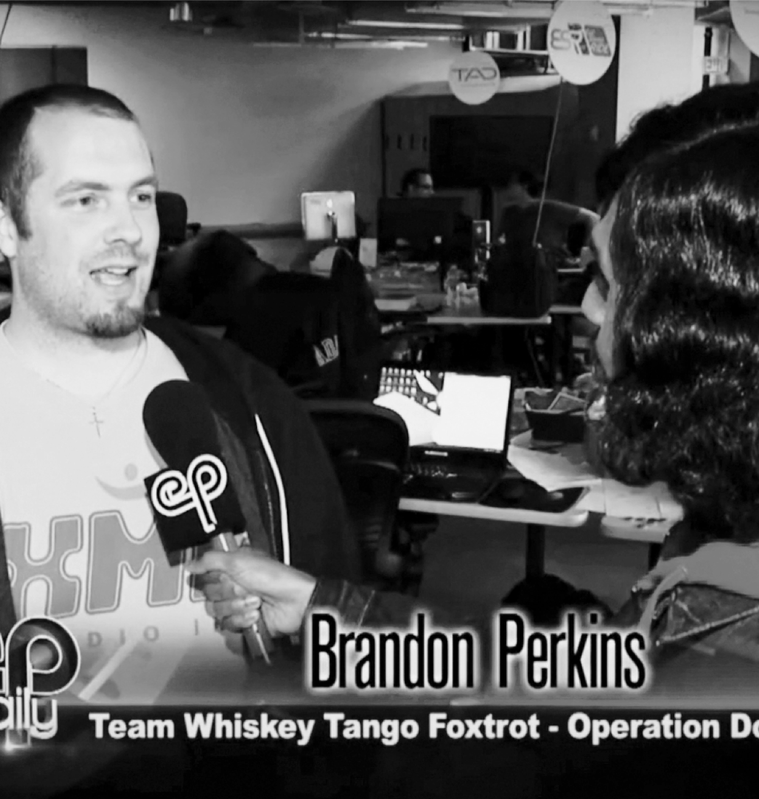











Media
The GCA⁴ had a combined media reach of nearly 8 million and 600,000+ student reach.
GCA³ Hackathon Participant
January 2014, GCA³ Ryerson DMZ HUB, Toronto
Notes:
Photo Layout 2

Slide 5
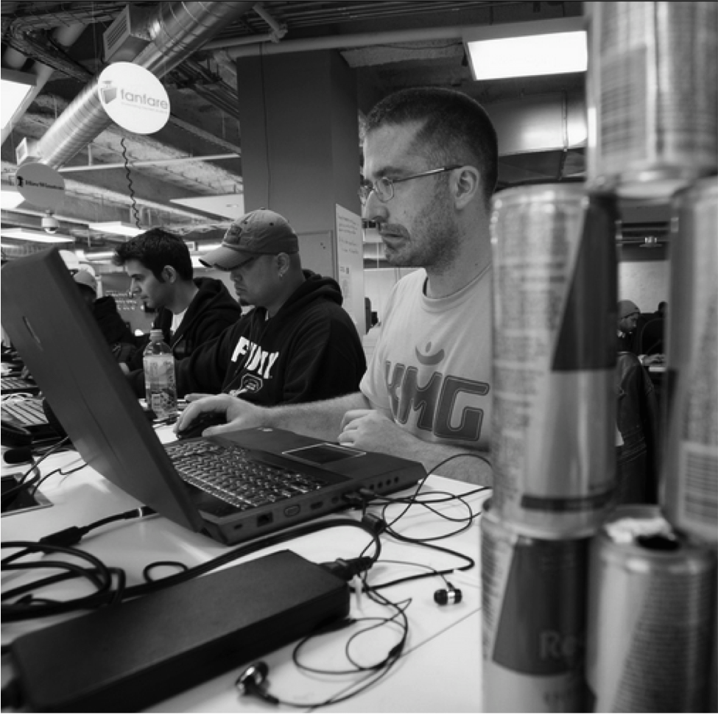
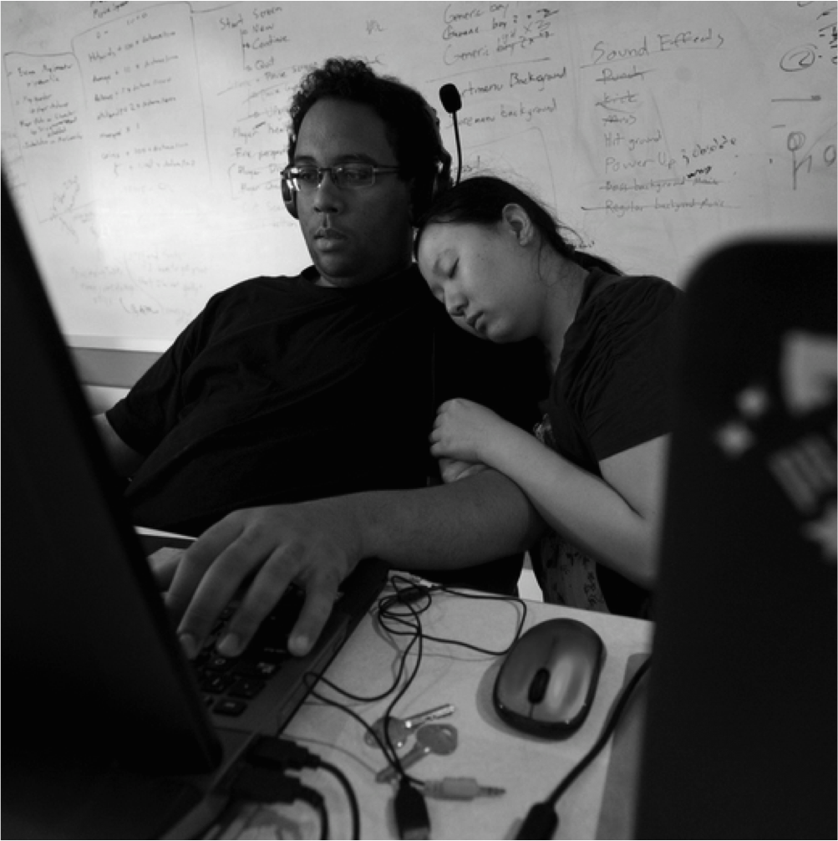
GCA PARTICIPANTS
Who are they?
WHO
University and college students with a high level of technical skills, looking for the experience to pursue a career as a software developer and/or digital designer.
LOCATION
Universities and college campuses across Canada
INTERESTS
Games, technology, mobile,
AGE
17-27
Team Friend Boat, $25,000 Grand Prize winner from the Ontario Institute of Technology.
After refueling with red bull, GCA³ participants are back to hack at the Ryerson DMZ GCA HUB.
Power naps are the way to go at Hackathons. This adorable pair of GCA³ participants is catching some zzzzz’s.
GCA Teams celebrating finishing their games at the University of Toronto HUB.
Notes:
One Column Layout

Slide 6

GCA5
Event Details
WHEN
Fall 2015
PARTICIPATION FORECAST
20 HUBs
500+ game makers
135+ teams
ESTIMATED GAMES SUBMITTED
130+ games
BUZZ
Targeted media coverage in every province across Canada, and live television coverage from every campus newspaper. Built in custom branding experiences at top 10 HUBS
Notes:
One Column Layout

Slide 7
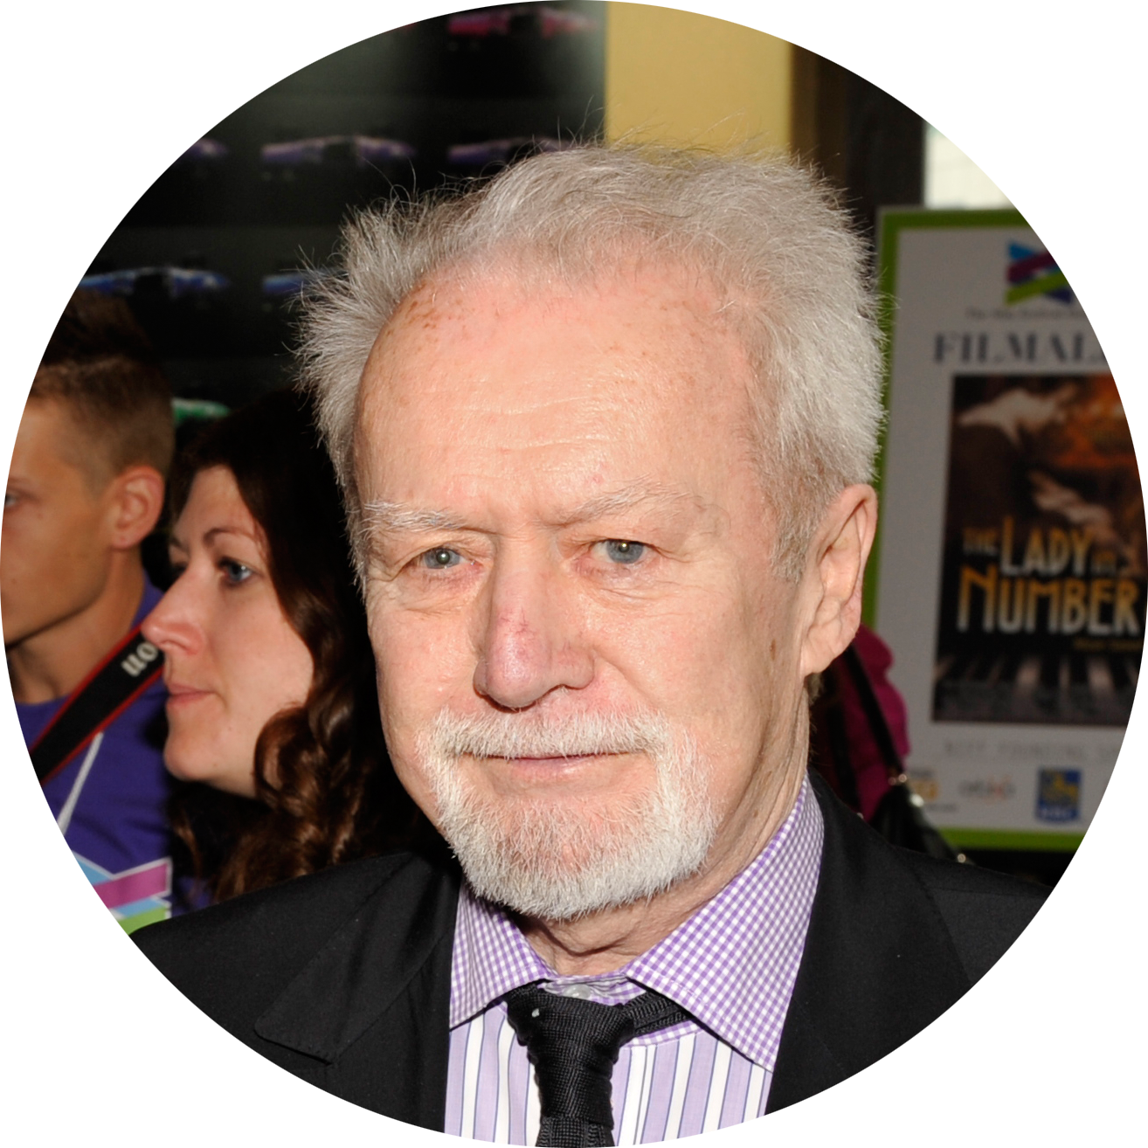

“We expect nothing less than the students to emerge from GCA3 with learning more about commercial software development than any other experience in their student careers,”
Bill Marshall
Founder of the Toronto International Film Festival, and a member of the GCA3 judging panel
”It’s great to see the young Canadian talent we have… the innovation, thinking outside the box… for me, this is a real passion."
Tony Clement
The Hon. Tony Clement, President of Treasury Board of Canada and a member of the GCA4 judging panel
Notes:
Quote Layout 1

Slide 8
WHAT VALUE DOES THE GCA OFFER
XX
We can connect your brand directly with the 18-25 year old university and college student demographic.
We can base the GCA5 theme around your brand which would result in games being built around your brand, or with your brand's elements
We can empower your brand to tap into a new community and expand and strengthen your existing community.
We can get the student demographic to engage with your brand and products
We can provide an opportunity to recruit from this young technically talented group of future graduates
Notes:
One Column Layout

Slide 9
PLATINUM SPONSORSHIP
PLATINUM Level Sponsor $25,000
Branding/naming rights over GCA5
(ex. Your Co presents: the Great Canadian Appathon 5)
Advisory role in creative execution of GCA5
(think “light touch, high impact”)
Speaking slot of your choosing at the hackathon event
Right to pick the GCA theme, allowing you to base all the games created at the GCA around your brand
Includes ALL GOLD level sponsorship perks listed on the next page
Notes:
One Column Layout

Slide 10
GOLD SPONSORSHIP
GOLD Level Sponsor $10,000
recruiting access to all GCA participants
Shout-out at opening and closing ceremonies
30 minute breakout talk during hackathon event
Receive 1 spot on the GCA judging panel
A custom news release will be written about the Gold Sponsors role in making the GCA possible.
Gold Sponsor products or services will be integrated into the GCA
Gold Sponsor’s logo will be on all GCA media releases, signs, banners and printed materials and GCA swag (t-shirts, bags, hats etc.)
Gold Sponsor brand integration into GCA social media plan
Notes:
One Column Layout

Slide 11
SILVER SPONSORSHIP
GOLD Level Sponsor $5,000
One of five category prizes named after each Silver Sponsor
Silver Sponsor included in GCA media releases, GCA signs and banners, printed materials and GCA swag
Silver sponsorship details and links to sponsors website will be on the GCA website,
Opportunity to provide marketing materials and giveaways in participants swag bags
Silver sponsors can promote their products, and services at the HUBs and engage with participants
Notes:
One Column Layout

Slide 12
BRONZE SPONSORSHIP
GOLD Level Sponsor $10,000
Sponsor recognition on GCA HUB signage and all GCA advertising and promotional material
Sponsor recognition on the GCA webpage and link to sponsors website
Opportunity to provide marketing materials and giveaways in participants swag bags
Notes:
One Column Layout

Slide 13
PLATINUM SPONSORSHIP
PLATINUM Level Sponsor $25,000
Branding/naming rights over GCA5
(e.g.Your Co presents: the Great Canadian Appathon 5)
Advisory role in creative execution of GCA5
(think “light touch, high impact”)
Right to pick the GCA theme, allowing you to base all the games created at the GCA around your brand
Includes ALL GOLD level sponsorship perks listed on the next page
Notes:
One Column Layout

Slide 14
GOLD SPONSORSHIP
GOLD Level Sponsor $10,000
Primary recruiting access to all GCA participants
Receive 1 spot on the GCA judging panel
A custom news release will be written about the Gold Sponsors role in making the GCA possible.
Quotes from Gold Sponsor can be included in news release
Gold Sponsor products or services will be integrated into the GCA
Gold Sponsor’s logo will be on all GCA media releases
Gold Sponsor’s logo will be on all GCA signs, banners and printed materials and GCA swag (t-shirts, bags, hats and more)
Gold Sponsor’s logo on all of the official GCA swag
Product placement in GCA swag bags
Gold Sponsor brand integration into GCA social media plan
Notes:
One Column Layout

Slide 15
GCA HISTORY
Largest competitive hackathon in Canada for 4 times running
GCA⁴
Jan 2014
All Provinces
40+ Schools
150+ Teams
500+ Students
100+ Games
GCA³
Sept 2012
GCA²
Oct 2011
GCA
Mar 2011
4 Provinces
7 Schools
94 Teams
296 Students
54 Games
Oct 2011

Slide 16
GCA HISTORY
Largest competitive hackathon in Canada for 4 times running
GCA
GCA²
GCA³
GCA⁴
Mar 2011
Oct 2011
Sept 2012
Jan 2014
4 Provinces
7 Schools
94 Teams
296 Students
54 Games
All Provinces
40+ Schools
150+ Teams
500+ Students
100+ Games
Oct 2011

Slide 17
Participant Experience
“The appathon, in my opinion, was the best way to really put all the information we studied and practiced during class hours into something physical and concrete, something that could be measured and judged in the real world and see what we could accomplish as a team.”
GCA Participant
“You can take courses and develop your programming knowledge, but in a competition you have to think on your feet and troubleshoot quickly – those are very valuable skills”
Professor of Physics & Computer Science at Laurier University
Notes:
Quote Layout 2

Slide 18
THANK YOU FOR YOUR TIME
We’re excited to work with you!
Patti Mikula, Co-Founder & CEO
patti@hackworks.com
Notes:
Thank you slide

